Slide 1


EMPLOYEE DATA ANALYSIS USING EXCEL
STUDENT NAME :
N.K.ANUSUYA
REGISTER NO :
2213371036103
DEPARTMENT :
B.COM (GENERAL)
COLLEGE :
QUAID- E-MILLATH COLLEGE

Slide 2



PROJECT TITLE
EMPLOYEE PERFORMANCE ANALYSIS USING EXCEL

Slide 3
1.
Problem Statement
2.
Project Overview
3.
End Users
Agenda
4.
Our Solution and proposition
5.
Dataset Description
6.
Modelling Approach
7.
Results and Discussion

Slide 4


PROBLEM STATEMENT
We have to track the performance of employees work motive for the organization and So that we can completely focus on the growth and structure of the organization and also to develop their personal skills and talents.
We have to motivate the best and executive employees with increments, promotion and bonus.
We have to train and motivate the under developed employees in a and effective manner with proper specifications.
*
*
*

Slide 5

PROJECT OVERVIEW
EMPLOYEE DATA ANALYSIS
Analysing the performance of the employees by considering the various factors like Gender, Performance score , Ratings and their Achievements , inorder to identify the trends and patterns of different categories of employees like high, medium and low.

Slide 6

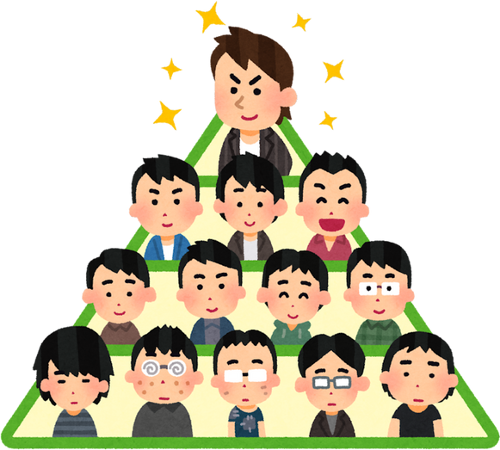



WHO ARE THE END OF USERS ?
EMPLOYEE
EMPLOYEE
HIERARCHY
MANAGER
EMPLOYER

Slide 7


OUR SOLUTION AND IT'S VALUE PROPOSITION
– TO IDENTIFY THE MISSING DATA
– FOR THE PURPOSE OF REMOVING THE UNWANTED DATA.
- FOR IDENTIFYING THE PERFORMANCRE THE EMPLOYEES .
- TO CONVERT THE DATA INTO SHORT SUMMARY .
– DATA VISUALIZATION
CONDITIONAL FORMATTING
FILTER
FORMULA
PIVOT TABLE
GRAPH

Slide 8

DATASET DESCRIPTION
DATASET TAKEN FROM KAGGLE
THERE ARE 26-FEATURES IN TECHNIQUES
WE ARE ONLY CONSIDERING 9 FEATURES HERE
EMPLOYEE – ID CAN BE USED IN A NUMERICAL VALUES.
EMPLOYEE NAME & ID IS SHOWN AS A TEXT
IDENTIFY THE EMPLOYEE TYPE
HIS PERFORMANCE LEVEL
& GENDER – MALE , FEMALE
EMPLOYEE RATING MUST BE IN NUMERICAL TERMS

Slide 9

THE "WOW" IN OUR SOLUTION
PERFORMANCE LEVEL=IF(Z8>=5, "VERY HIGH", IF(Z8>=4, "HIGH", IF(Z8>=3, "MEDIUM", "LOW")))

Slide 10

MODELLING
DATA COLLECTION :
Downloaded the employee data performance from EDUNET DASHBOARD
FEATURES COLLECTION:
Identify the each and every features and collected from kaggle
DATA CLEANING :
Identified the missing values.
Filtering and sorting the missing values
Highlighting the need Columns and that term only take for creating the pivot table
SUMMARY :
Create the Pivot table on the base of data
Creating the Pie Chart for the pivot table
VISUALIZATION :
Finally visualising the Graph & Excel

Slide 11
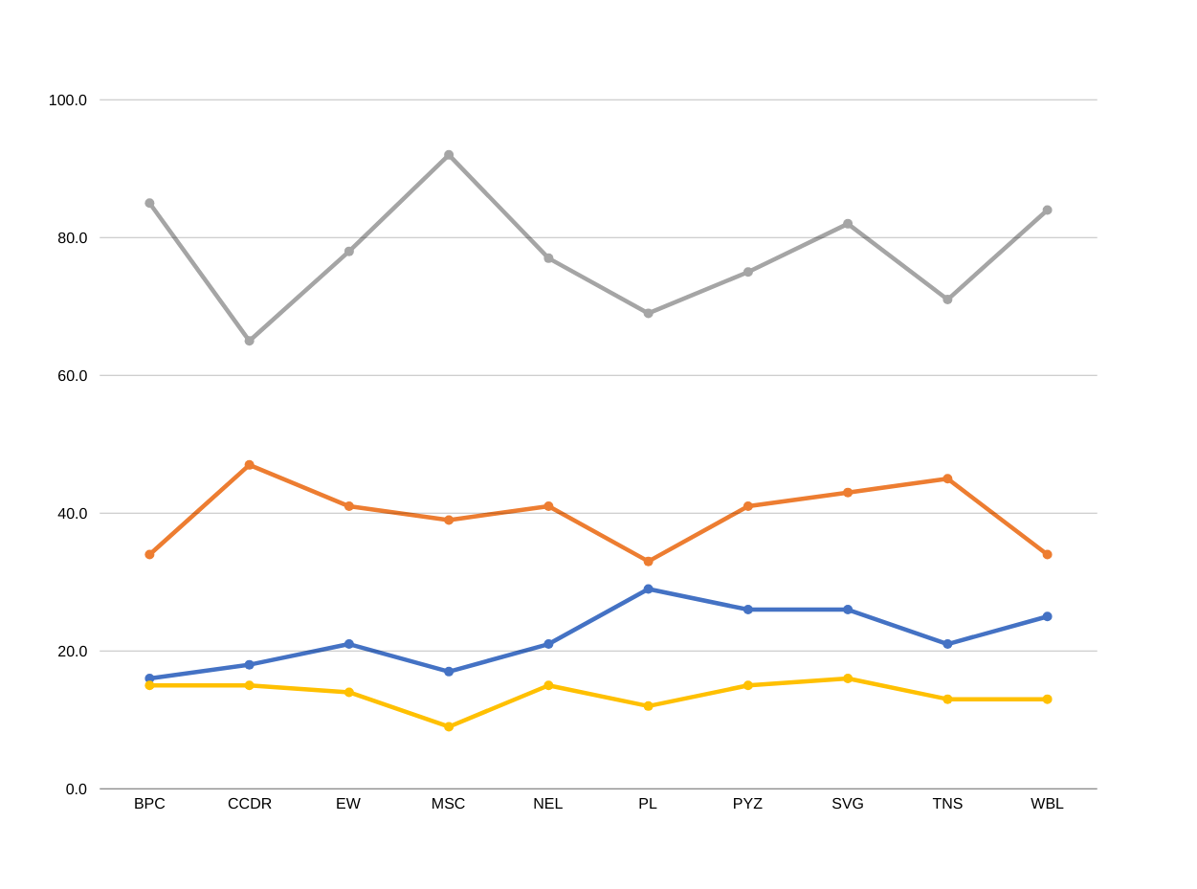
RESULTS
EMPLOYEE PERFORMANCE ANALYSIS
*
Medium
*
Low
*
High
*
very high

Slide 12


RESULTS
HIGH LEVEL PERFORMANCE ANALYSIS

Slide 13



CONCLUSION
EMPLOYEE DATA ANALYSIS
WE HAVE TO MOTIVAYE THE EMPLOYEES TO DEVELOP THEIR SKILLS AND TALENTS TO ACHIEVE THE ORGANISATIONAL GOALS AND OBJECTIVES TO REACH THE PLACE OF HIGH LEVEL PERFORMANCE TO SUSTAIN THE GOALS AND TARGETS.
﻿
WE HAVE TO TRAIN AND DEVELOP THE EMPLOYEES WITH BETTER OUTCOME TO REACH THE ORGANISATIONAL GOALS.
BY COMPARING THE PERFORMANCE OF THE EMPLOYEES. THE EMPLOYEES ARE HIGHER IN NUMBER. THERE ARE MORE PEOPLE IN AVERAGE LEVEL EMPLOYEES.

Slide 14
Thank You

